Slide 1
Microsoft Visual C#: An Introduction to Object-Oriented Programming
7th Edition
Chapter 11
Exception Handling
© 2018 Cengage. All Rights Reserved. May not be copied, scanned, or duplicated, in whole or in part, except for use as permitted in a license distributed with a certain product or service or otherwise on a password-protected website for classroom use.

Slide 2
Objectives (1 of 2)
11.1 Describe exceptions, the Exception class, and SystemExceptions
11.2 Compare traditional and object-oriented error-handling methods
11.3 Use the Exception class’s ToString() method and Message property
11.4 Catch multiple exceptions
11.5 Describe the structure of the TryParse() methods
© 2018 Cengage. May not be copied, scanned, or duplicated, in whole or in part, except for use as permitted in a license distributed with a certain product or service or otherwise on a password-protected website for classroom use.

Slide 3
Objectives (2 of 2)
11.6 Use the finally block
11.7 Handle exceptions thrown from outside methods
11.8 Trace Exception objects through the call stack
11.9 Create your own Exception classes
11.10 Rethrow Exceptions
© 2018 Cengage. May not be copied, scanned, or duplicated, in whole or in part, except for use as permitted in a license distributed with a certain product or service or otherwise on a password-protected website for classroom use.

Slide 4
Understanding Exceptions (1 of 2)
Exception
Any error condition or unexpected behavior in an executing program
Caused by errors in program logic or insufficient system resources
Terminates the program unless exceptions are handled
Exception handling
Object-oriented techniques used to manage such errors
Exceptions are objects of the Exception class or one of its derived classes
© 2018 Cengage. May not be copied, scanned, or duplicated, in whole or in part, except for use as permitted in a license distributed with a certain product or service or otherwise on a password-protected website for classroom use.

Slide 5
Understanding Exceptions (2 of 2)
Most exceptions derive from three classes:
Predefined Common Language Runtime exception classes derived from SystemException
User-defined application exception classes you derive from ApplicationException
The Exception class which is the parent of SystemException and ApplicationException
© 2018 Cengage. May not be copied, scanned, or duplicated, in whole or in part, except for use as permitted in a license distributed with a certain product or service or otherwise on a password-protected website for classroom use.

Slide 6
Purposely Generating a SystemException (1 of 4)
You can deliberately generate a SystemException by forcing a program to contain an error
Example: Dividing an integer by zero
Termination of the program is abrupt and unforgiving
Object-oriented error-handling techniques provide more elegant solutions
With exception handling, a program can continue after dealing with a problem
Especially important in mission-critical applications - any process that is crucial to an organization
© 2018 Cengage. May not be copied, scanned, or duplicated, in whole or in part, except for use as permitted in a license distributed with a certain product or service or otherwise on a password-protected website for classroom use.

Slide 7
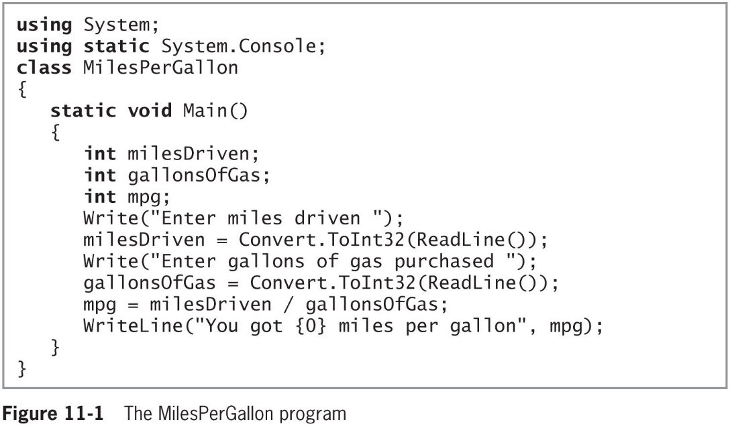
Purposely Generating a SystemException (2 of 4)
© 2018 Cengage. May not be copied, scanned, or duplicated, in whole or in part, except for use as permitted in a license distributed with a certain product or service or otherwise on a password-protected website for classroom use.

Slide 8
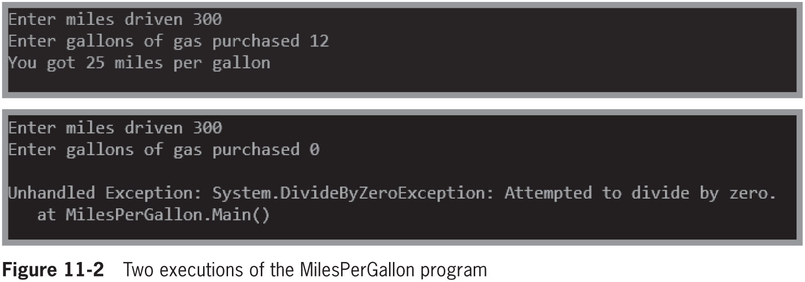
Purposely Generating a SystemException (3 of 4)
© 2018 Cengage. May not be copied, scanned, or duplicated, in whole or in part, except for use as permitted in a license distributed with a certain product or service or otherwise on a password-protected website for classroom use.

Slide 9
Purposely Generating a SystemException (4 of 4)
Programs that can handle exceptions appropriately are said to be more fault tolerant and robust than those that do not
Fault-tolerant applications are designed so that they continue to operate, possibly at a reduced level, when some part of the system fails
Robustness represents the degree to which a system is resilient to stress, maintaining correct functioning
© 2018 Cengage. May not be copied, scanned, or duplicated, in whole or in part, except for use as permitted in a license distributed with a certain product or service or otherwise on a password-protected website for classroom use.

Slide 10
Comparing Traditional and Object-Oriented Error-Handling Methods
Check a variable’s value with an if statement before attempting to divide it into another number
Prevents division by zero
However, it does not really “handle an exception”
Is efficient if you think it will be a frequent problem
Has little “overhead”
Otherwise, create an Exception object
Advantage to using exception handling instead of decision making to control errors:
When a program’s main logic is interrupted by a series of if statements and decisions that might detect errors, the program can become more complicated and difficult to understand
© 2018 Cengage. May not be copied, scanned, or duplicated, in whole or in part, except for use as permitted in a license distributed with a certain product or service or otherwise on a password-protected website for classroom use.

Slide 11
Understanding Object-Oriented Exception-Handling Methods (1 of 5)
Object-oriented exception handling uses three unique terms: try, throw, and catch
You “try” a procedure that may not complete correctly
A method that detects an error condition “throws” an exception
The block of code that processes the error “catches” the exception
try block
Contains statements that can produce an error
Code at least one catch block or finally block immediately following a try block
© 2018 Cengage. May not be copied, scanned, or duplicated, in whole or in part, except for use as permitted in a license distributed with a certain product or service or otherwise on a password-protected website for classroom use.

Slide 12
Understanding Object-Oriented Exception-Handling Methods (2 of 5)
catch block
Can “catch” one type of Exception
You must code at least one catch block or finally block immediately following a try block
Create a catch block by typing the following elements:
The keyword catch
Parentheses containing an Exception type and, optionally, a name for an instance of the Exception type
A pair of curly braces containing statements that deal with the error condition
© 2018 Cengage. May not be copied, scanned, or duplicated, in whole or in part, except for use as permitted in a license distributed with a certain product or service or otherwise on a password-protected website for classroom use.

Slide 13
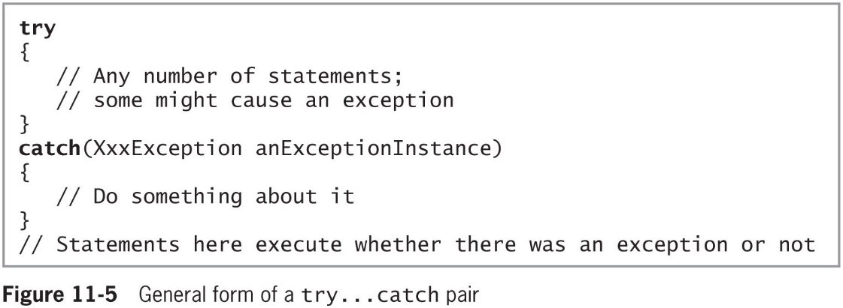
Understanding Object-Oriented Exception-Handling Methods (3 of 5)
© 2018 Cengage. May not be copied, scanned, or duplicated, in whole or in part, except for use as permitted in a license distributed with a certain product or service or otherwise on a password-protected website for classroom use.

Slide 14
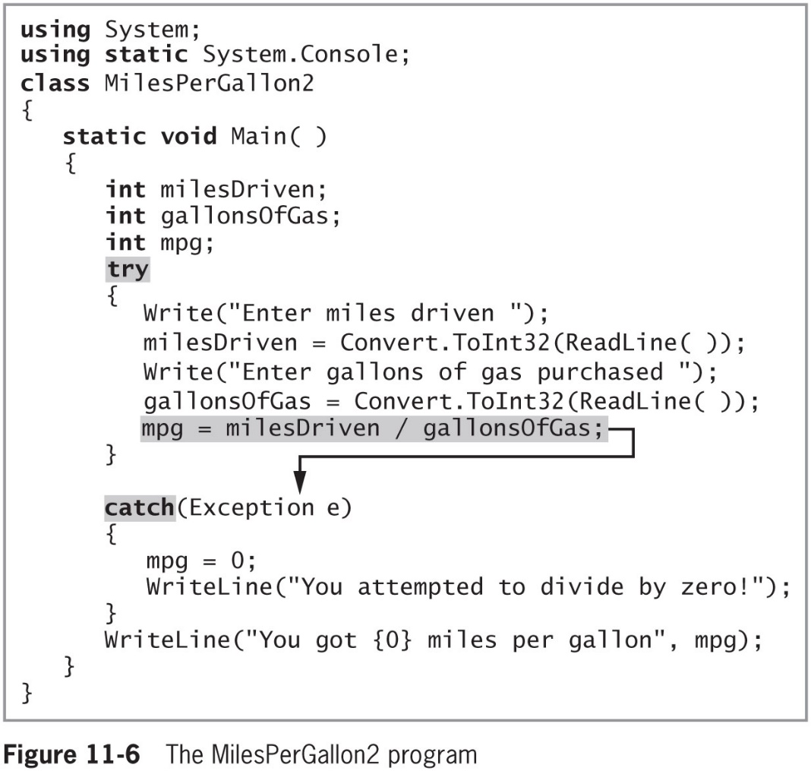
Understanding Object-Oriented Exception-Handling Methods (4 of 5)
© 2018 Cengage. May not be copied, scanned, or duplicated, in whole or in part, except for use as permitted in a license distributed with a certain product or service or otherwise on a password-protected website for classroom use.

Slide 15
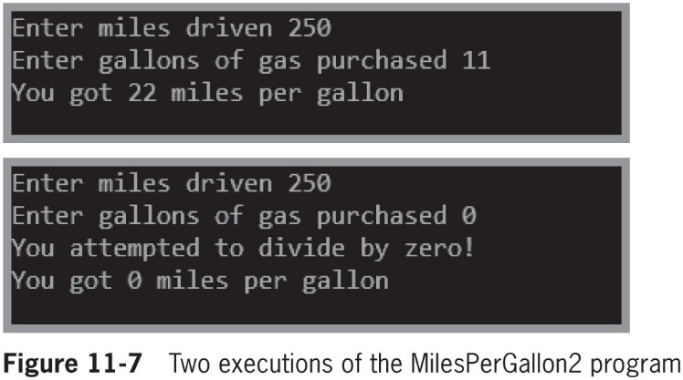
Understanding Object-Oriented Exception-Handling Methods (5 of 5)
© 2018 Cengage. May not be copied, scanned, or duplicated, in whole or in part, except for use as permitted in a license distributed with a certain product or service or otherwise on a password-protected website for classroom use.

Slide 16
Using the Exception Class’s ToString() Method and Message Property (1 of 5)
The Exception class overrides ToString()
Provides a descriptive error message
The user can receive precise information about the nature of any Exception that is thrown
© 2018 Cengage. May not be copied, scanned, or duplicated, in whole or in part, except for use as permitted in a license distributed with a certain product or service or otherwise on a password-protected website for classroom use.

Slide 17
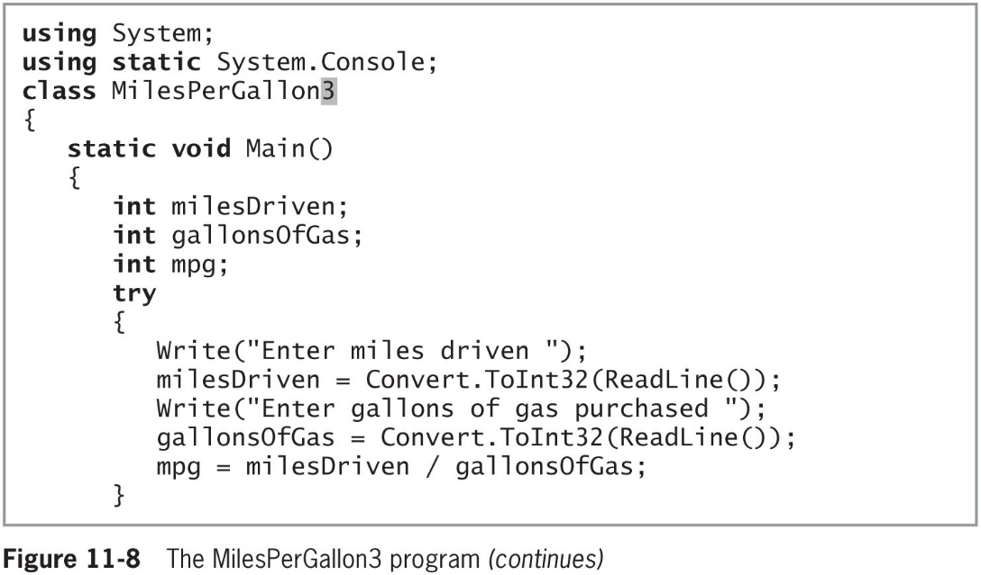
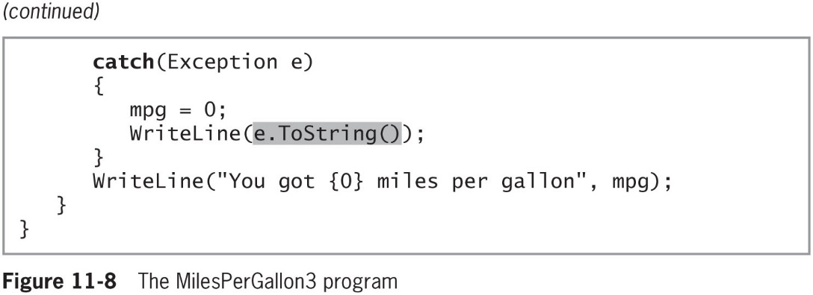
Using the Exception Class’s ToString() Method and Message Property (2 of 5)
© 2018 Cengage. May not be copied, scanned, or duplicated, in whole or in part, except for use as permitted in a license distributed with a certain product or service or otherwise on a password-protected website for classroom use.

Slide 18
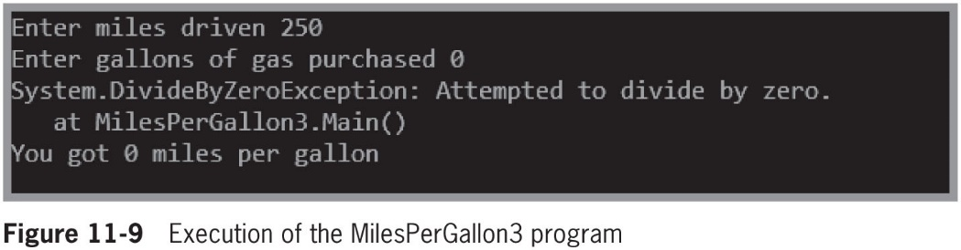
Using the Exception Class’s ToString() Method and Message Property (3 of 5)
© 2018 Cengage. May not be copied, scanned, or duplicated, in whole or in part, except for use as permitted in a license distributed with a certain product or service or otherwise on a password-protected website for classroom use.

Slide 19
Using the Exception Class’s ToString() Method and Message Property (4 of 5)
Exception class Message property
Contains useful information about an Exception
getType() method
Indicates the name of the class
© 2018 Cengage. May not be copied, scanned, or duplicated, in whole or in part, except for use as permitted in a license distributed with a certain product or service or otherwise on a password-protected website for classroom use.

Slide 20
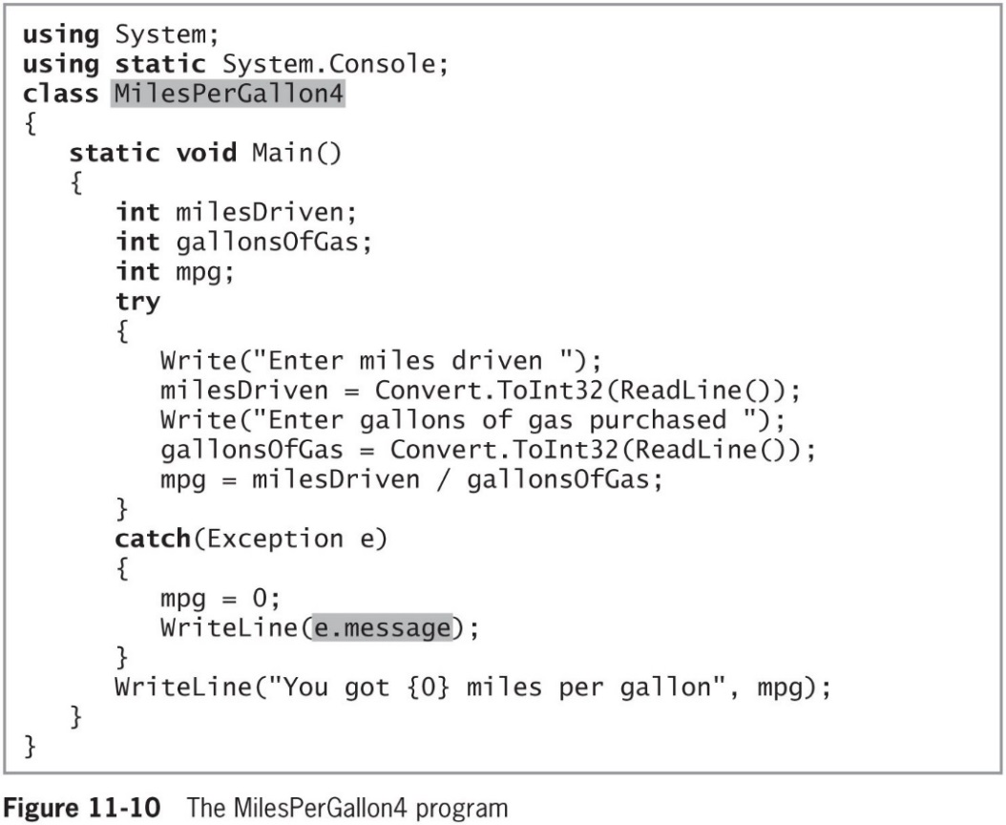
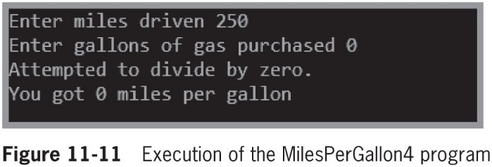
Using the Exception Class’s ToString() Method and Message Property (5 of 5)
© 2018 Cengage. May not be copied, scanned, or duplicated, in whole or in part, except for use as permitted in a license distributed with a certain product or service or otherwise on a password-protected website for classroom use.

Slide 21
Creating Multiple Exceptions (1 of 5)
You can place as many statements as you need within a try block
Only the first error-generating statement throws an Exception
Multiple catch blocks are examined in sequence until a match is found for the Exception that occurred
Various Exceptions can be handled by the same catch block
© 2018 Cengage. May not be copied, scanned, or duplicated, in whole or in part, except for use as permitted in a license distributed with a certain product or service or otherwise on a password-protected website for classroom use.

Slide 22
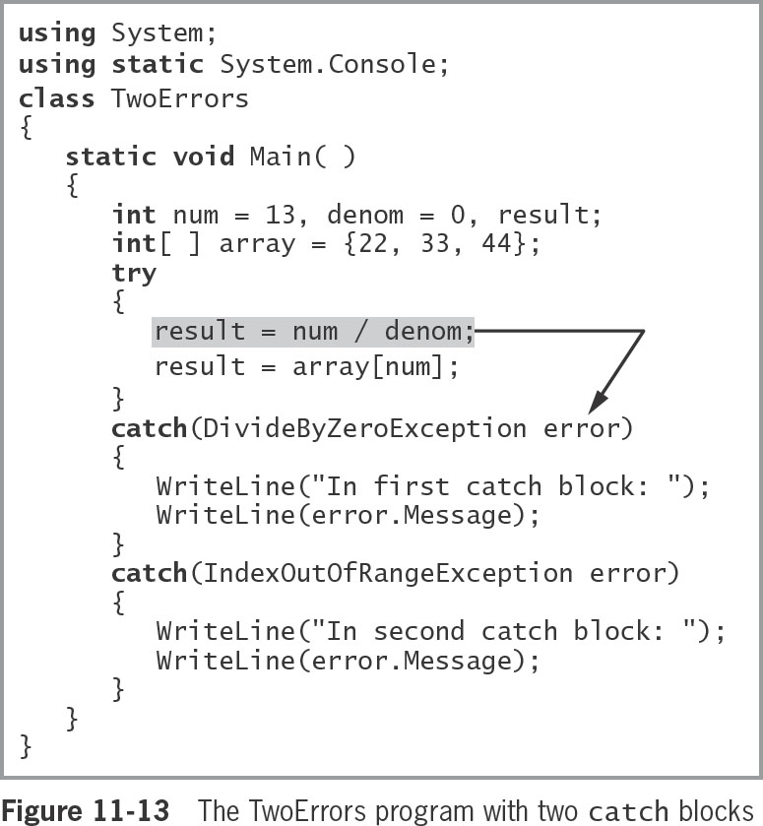
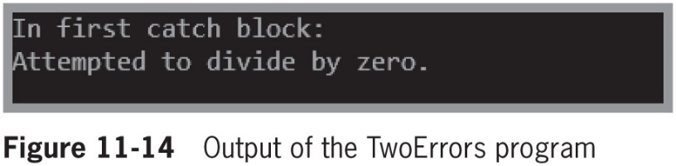
Creating Multiple Exceptions (2 of 5)
© 2018 Cengage. May not be copied, scanned, or duplicated, in whole or in part, except for use as permitted in a license distributed with a certain product or service or otherwise on a password-protected website for classroom use.

Slide 23
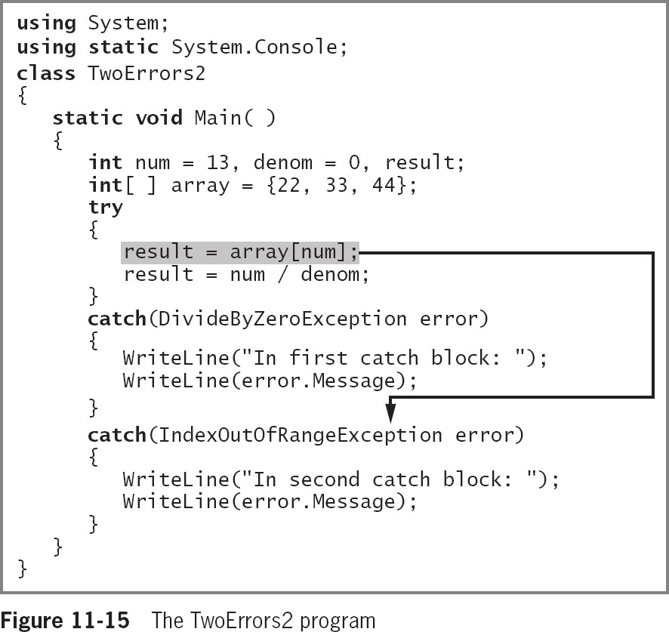
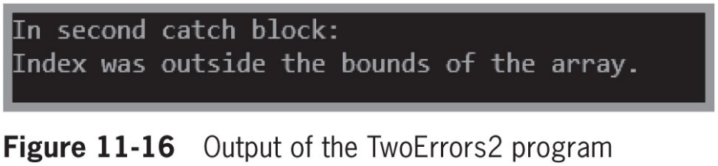
Creating Multiple Exceptions (3 of 5)
© 2018 Cengage. May not be copied, scanned, or duplicated, in whole or in part, except for use as permitted in a license distributed with a certain product or service or otherwise on a password-protected website for classroom use.

Slide 24
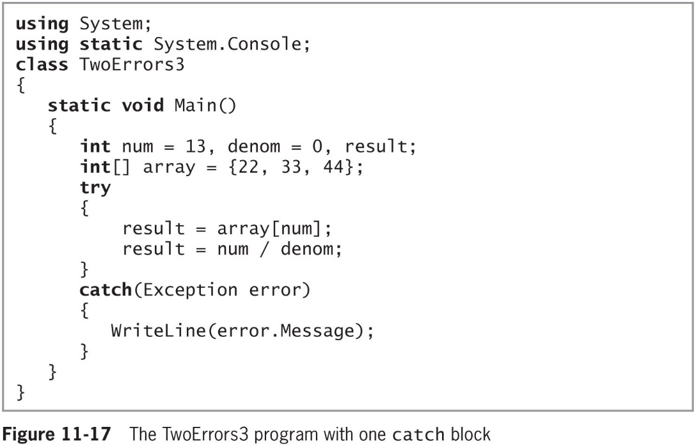
Creating Multiple Exceptions (4 of 5)
© 2018 Cengage. May not be copied, scanned, or duplicated, in whole or in part, except for use as permitted in a license distributed with a certain product or service or otherwise on a password-protected website for classroom use.

Slide 25
Creating Multiple Exceptions (5 of 5)
It is poor coding style for a method to throw more than three or four types of Exceptions
The method is trying to accomplish too many diverse tasks
The Exception types thrown are too specific and should be generalized
Unreachable blocks
Contain statements that can never execute under any circumstances because the program logic “can’t get there”
Programmers also call unreachable code dead code
© 2018 Cengage. May not be copied, scanned, or duplicated, in whole or in part, except for use as permitted in a license distributed with a certain product or service or otherwise on a password-protected website for classroom use.

Slide 26
Examining the Structure of the TryParse() Methods (1 of 2)
Allows the conversion of string data to another type without fear of generating uncaught exceptions
This was introduced in Chapter 8
if(!int.TryParse(inputString, out number))
number = DEFAULT_VALUE;
If you were to create a similar method using Try…Catch(), it might look like Figure 11-19 on the following slide
© 2018 Cengage. May not be copied, scanned, or duplicated, in whole or in part, except for use as permitted in a license distributed with a certain product or service or otherwise on a password-protected website for classroom use.

Slide 27
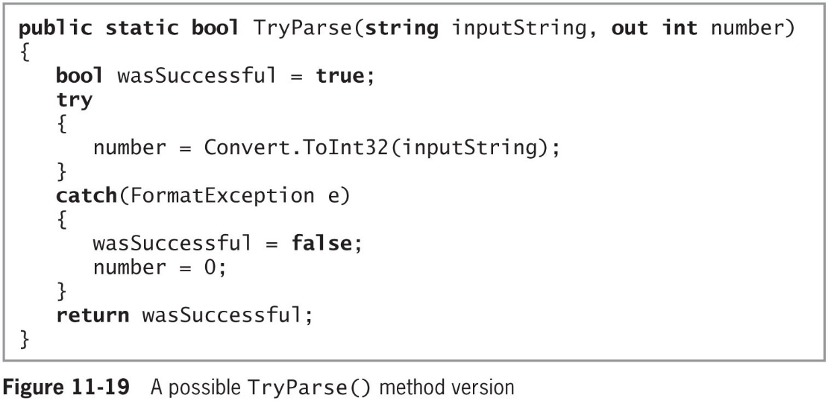
Examining the Structure of the TryParse() Methods (2 of 2)
© 2018 Cengage. May not be copied, scanned, or duplicated, in whole or in part, except for use as permitted in a license distributed with a certain product or service or otherwise on a password-protected website for classroom use.

Slide 28
Using the finally Block (1 of 3)
finally block
Contains actions to perform at the end of a try…catch sequence
Executes whether the try block identifies any Exceptions or not
Used to perform clean-up tasks
A finally block executes no matter which of the following outcomes occurs:
The try ends normally
The try ends abnormally and the catch executes
The try ends abnormally and the catch does not execute
The try ends abnormally, the catch executes, but then the catch ends abnormally because an uncaught exception occurs
© 2018 Cengage. May not be copied, scanned, or duplicated, in whole or in part, except for use as permitted in a license distributed with a certain product or service or otherwise on a password-protected website for classroom use.

Slide 29
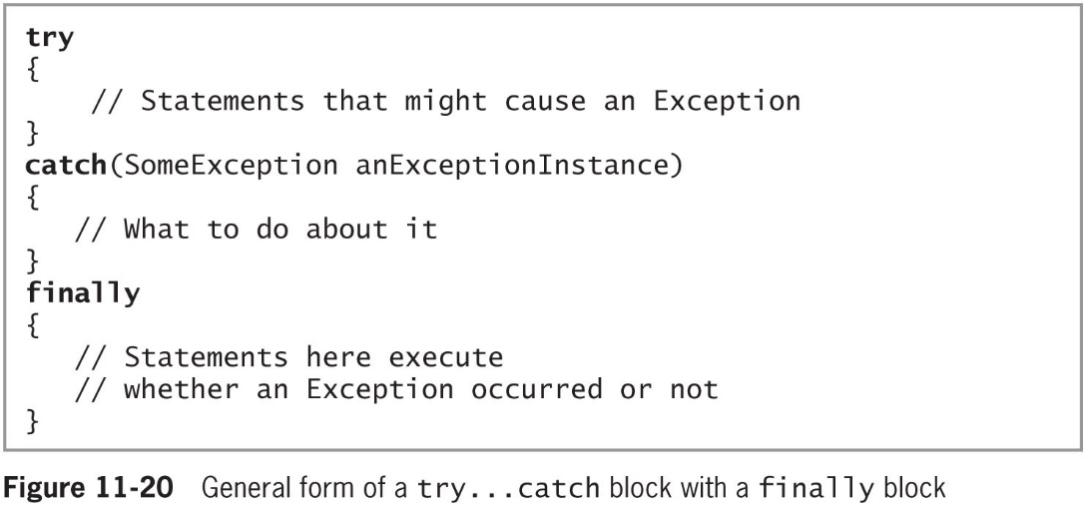
Using the finally Block (2 of 3)
© 2018 Cengage. May not be copied, scanned, or duplicated, in whole or in part, except for use as permitted in a license distributed with a certain product or service or otherwise on a password-protected website for classroom use.

Slide 30
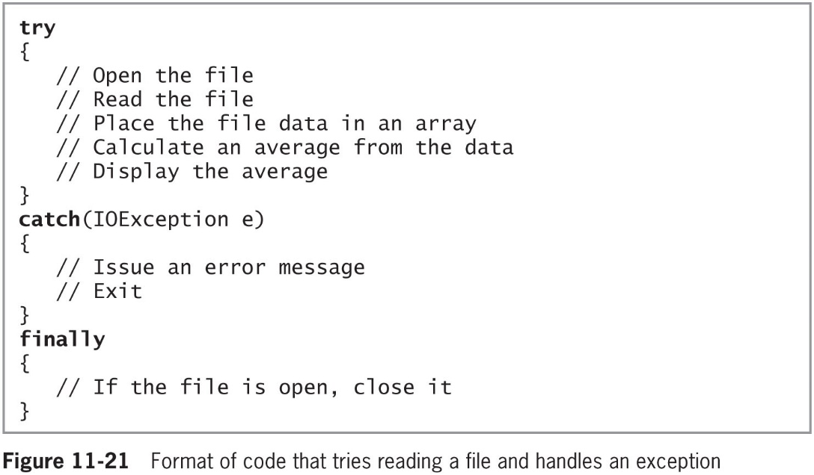
Using the finally Block (3 of 3)
© 2018 Cengage. May not be copied, scanned, or duplicated, in whole or in part, except for use as permitted in a license distributed with a certain product or service or otherwise on a password-protected website for classroom use.

Slide 31
Handling Exceptions Thrown from Outside Methods (1 of 5)
An advantage of using object-oriented exception-handling techniques:
The ability to deal with Exceptions appropriately as you decide how to handle them
When methods from other classes throw Exceptions, methods do not have to catch them
Your calling program can catch them, and you can decide what to do
© 2018 Cengage. May not be copied, scanned, or duplicated, in whole or in part, except for use as permitted in a license distributed with a certain product or service or otherwise on a password-protected website for classroom use.

Slide 32
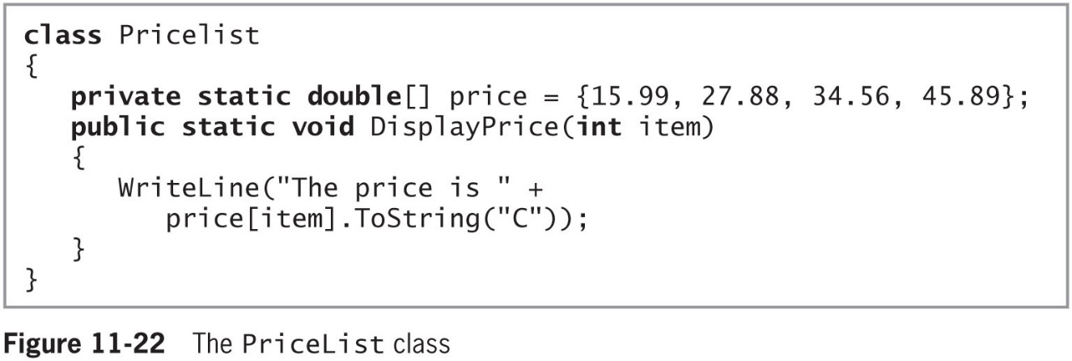
Handling Exceptions Thrown from Outside Methods (2 of 5)
© 2018 Cengage. May not be copied, scanned, or duplicated, in whole or in part, except for use as permitted in a license distributed with a certain product or service or otherwise on a password-protected website for classroom use.

Slide 33
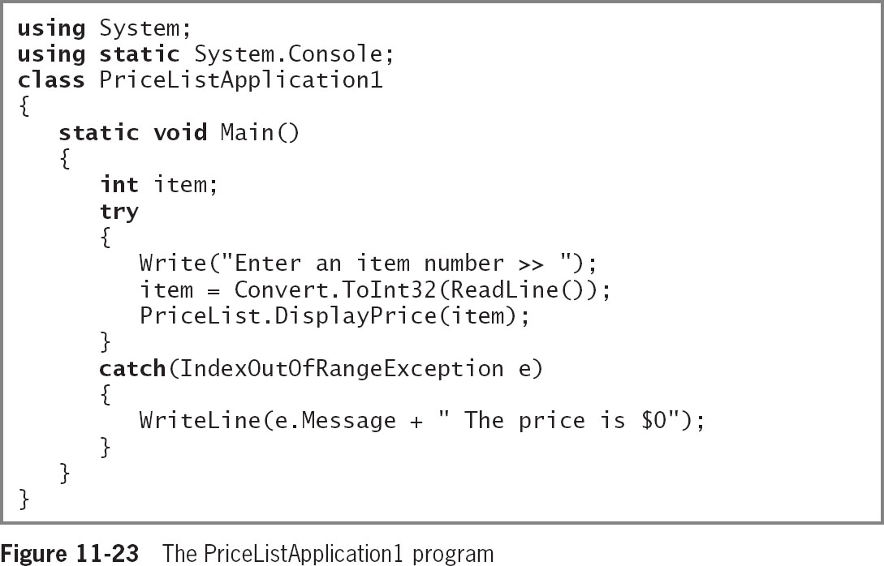
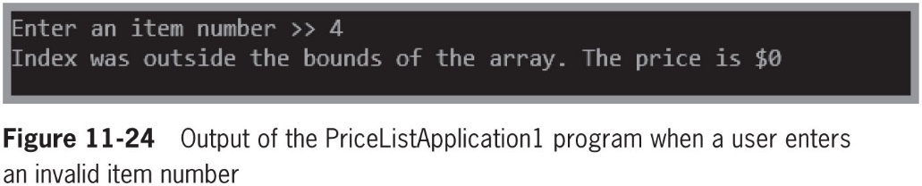
Handling Exceptions Thrown from Outside Methods (3 of 5)
© 2018 Cengage. May not be copied, scanned, or duplicated, in whole or in part, except for use as permitted in a license distributed with a certain product or service or otherwise on a password-protected website for classroom use.

Slide 34
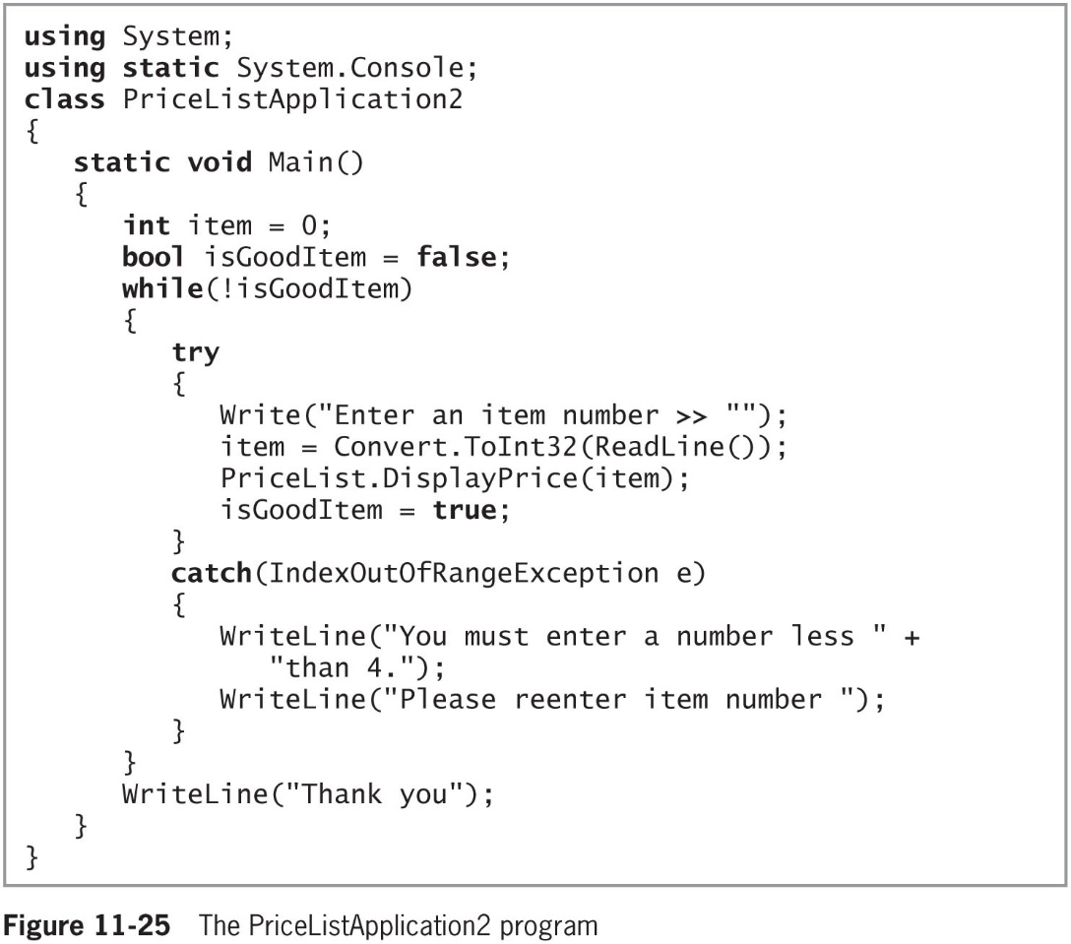
Handling Exceptions Thrown from Outside Methods (4 of 5)
© 2018 Cengage. May not be copied, scanned, or duplicated, in whole or in part, except for use as permitted in a license distributed with a certain product or service or otherwise on a password-protected website for classroom use.

Slide 35
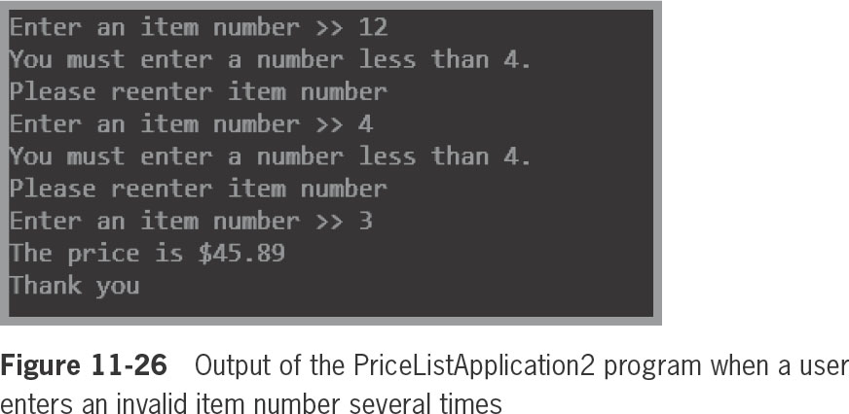
Handling Exceptions Thrown from Outside Methods (5 of 5)
© 2018 Cengage. May not be copied, scanned, or duplicated, in whole or in part, except for use as permitted in a license distributed with a certain product or service or otherwise on a password-protected website for classroom use.

Slide 36
Tracing Exception Objects Through the Call Stack
Call stack
The memory location where the computer stores the list of locations to which the system must return
If a method throws an Exception and does not catch it, the Exception is thrown to the next method “up” the call stack
Called propagating the exception
StackTrace property
Contains a list of methods in the call stack so you can determine the location of the Exception
© 2018 Cengage. May not be copied, scanned, or duplicated, in whole or in part, except for use as permitted in a license distributed with a certain product or service or otherwise on a password-protected website for classroom use.

Slide 37
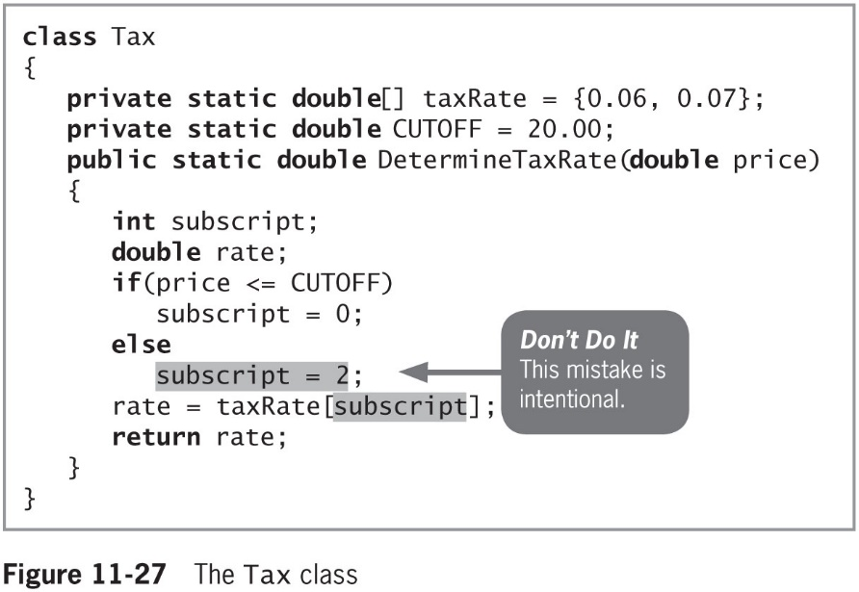
A Case Study: Using StackTrace (1 of 4)
© 2018 Cengage. May not be copied, scanned, or duplicated, in whole or in part, except for use as permitted in a license distributed with a certain product or service or otherwise on a password-protected website for classroom use.

Slide 38
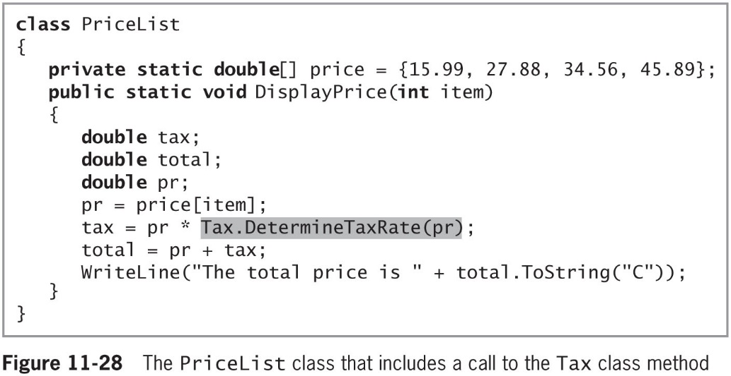
A Case Study: Using StackTrace (2 of 4)
© 2018 Cengage. May not be copied, scanned, or duplicated, in whole or in part, except for use as permitted in a license distributed with a certain product or service or otherwise on a password-protected website for classroom use.

Slide 39
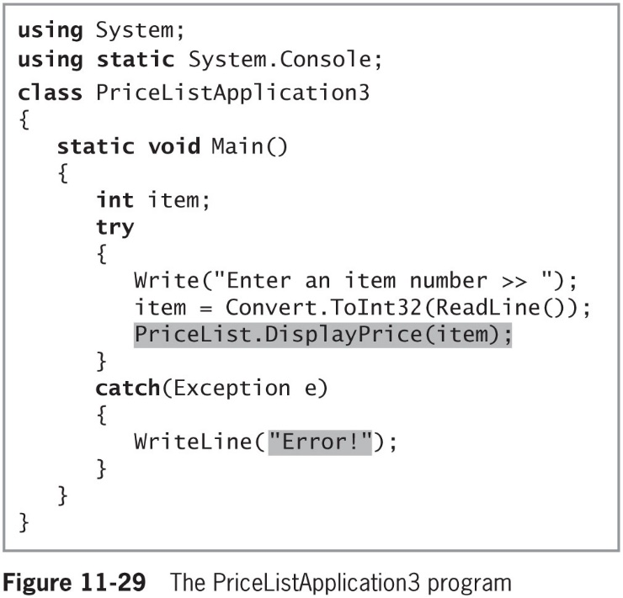
A Case Study: Using StackTrace (3 of 4)
© 2018 Cengage. May not be copied, scanned, or duplicated, in whole or in part, except for use as permitted in a license distributed with a certain product or service or otherwise on a password-protected website for classroom use.

Slide 40
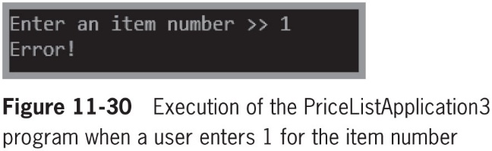
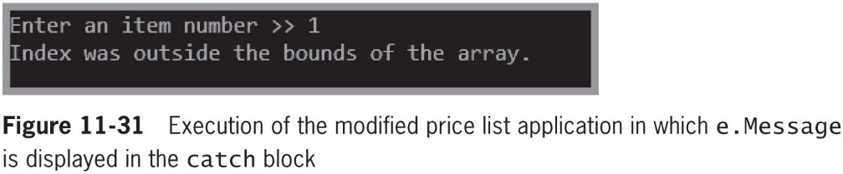
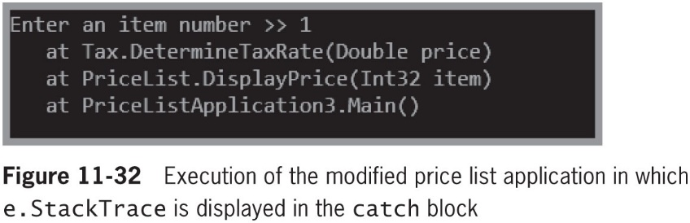
A Case Study: Using StackTrace (4 of 4)
© 2018 Cengage. May not be copied, scanned, or duplicated, in whole or in part, except for use as permitted in a license distributed with a certain product or service or otherwise on a password-protected website for classroom use.

Slide 41
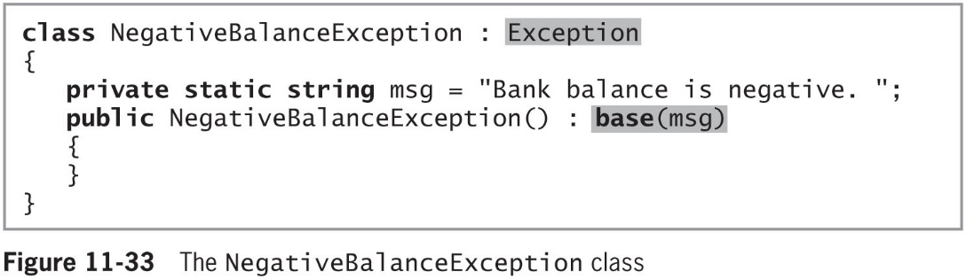
Creating Your Own Exception Classes (1 of 3)
To create your own Exception:
Extend the ApplicationException or the Exception class
© 2018 Cengage. May not be copied, scanned, or duplicated, in whole or in part, except for use as permitted in a license distributed with a certain product or service or otherwise on a password-protected website for classroom use.

Slide 42
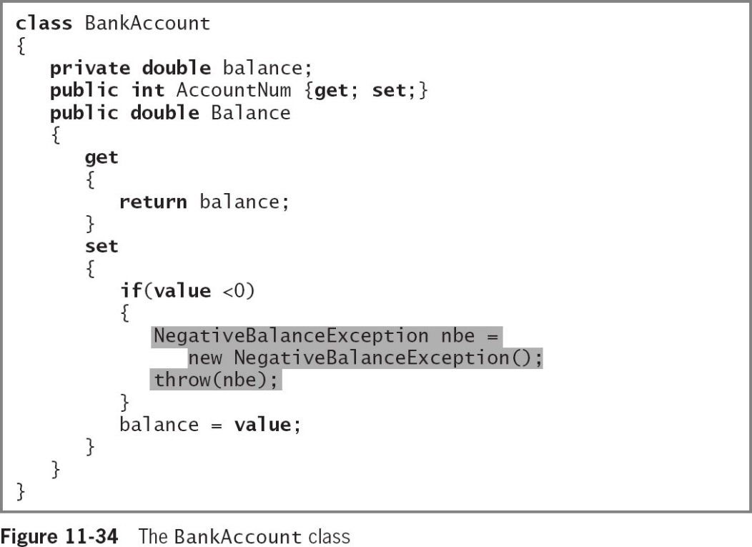
Creating Your Own Exception Classes (2 of 3)
When you create a BankAccount class like the one shown in Figure 11-34, you can create the Balance property set accessor to throw a NegativeBalanceException when a client attempts to set the balance to be negative
© 2018 Cengage. May not be copied, scanned, or duplicated, in whole or in part, except for use as permitted in a license distributed with a certain product or service or otherwise on a password-protected website for classroom use.

Slide 43
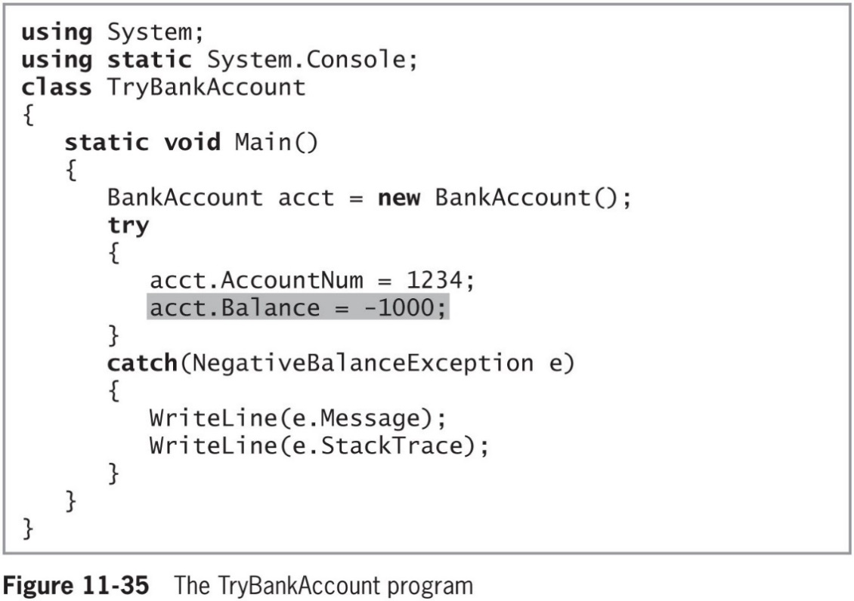
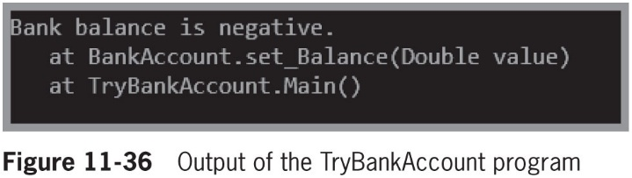
Creating Your Own Exception Classes (3 of 3)
© 2018 Cengage. May not be copied, scanned, or duplicated, in whole or in part, except for use as permitted in a license distributed with a certain product or service or otherwise on a password-protected website for classroom use.

Slide 44
Rethrowing an Exception (1 of 3)
Rethrow the exception
Let the calling method handle the problem
The method that catches an Exception does not have to handle it
Within a catch block, you can rethrow the exception that was caught by using the keyword throw with no object after it
© 2018 Cengage. May not be copied, scanned, or duplicated, in whole or in part, except for use as permitted in a license distributed with a certain product or service or otherwise on a password-protected website for classroom use.

Slide 45
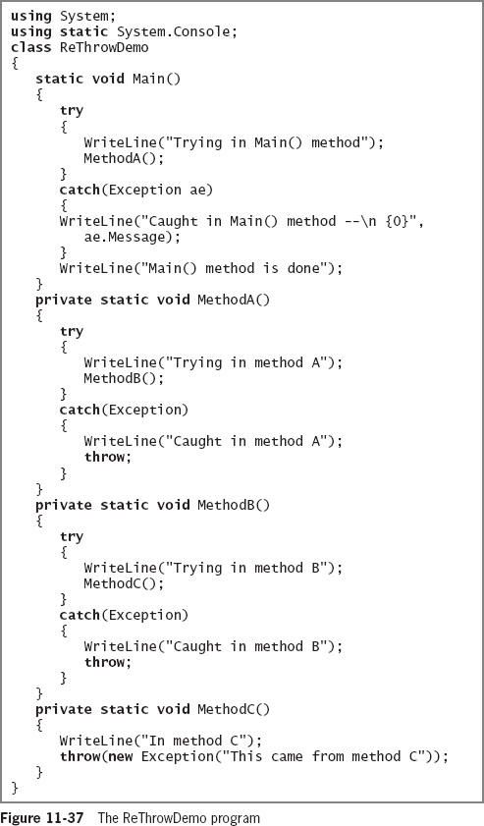
Rethrowing an Exception (2 of 3)
© 2018 Cengage. May not be copied, scanned, or duplicated, in whole or in part, except for use as permitted in a license distributed with a certain product or service or otherwise on a password-protected website for classroom use.

Slide 46
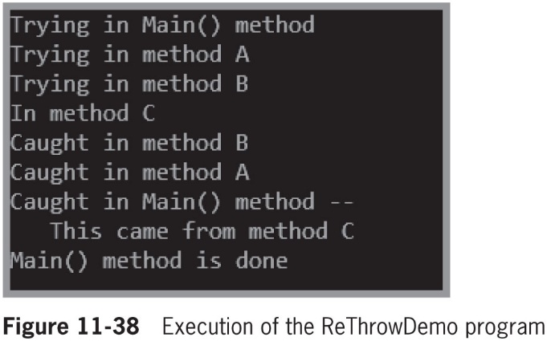
Rethrowing an Exception (3 of 3)
© 2018 Cengage. May not be copied, scanned, or duplicated, in whole or in part, except for use as permitted in a license distributed with a certain product or service or otherwise on a password-protected website for classroom use.

Slide 47
Chapter Summary (1 of 3)
An exception is any error condition or unexpected behavior in an executing program
You can purposely generate a SystemException by forcing a program to contain an error
When you think an error will occur frequently, it is most efficient to handle it in the traditional way
In object-oriented terminology, you “try” a procedure that may not complete correctly
Every Exception object contains a ToString() method and a Message property
© 2018 Cengage. May not be copied, scanned, or duplicated, in whole or in part, except for use as permitted in a license distributed with a certain product or service or otherwise on a password-protected website for classroom use.

Slide 48
Chapter Summary (2 of 3)
You can place as many statements as you need within a try block
Catch as many different Exceptions as you want
The TryParse() methods that you can use to convert strings to other data types without causing exceptions use exception-handling techniques internally
When you have actions to perform at the end of a try…catch sequence, use a finally block
When methods throw Exceptions, they don’t have to catch them
© 2018 Cengage. May not be copied, scanned, or duplicated, in whole or in part, except for use as permitted in a license distributed with a certain product or service or otherwise on a password-protected website for classroom use.

Slide 49
Chapter Summary (3 of 3)
If a method throws an Exception and does not catch it, then the Exception is thrown to the method that called the offending method
To create your own Exception that you can throw, you can extend the ApplicationException class or the Exception class
When you write a method that catches an Exception, your method does not have to handle the Exception
© 2018 Cengage. May not be copied, scanned, or duplicated, in whole or in part, except for use as permitted in a license distributed with a certain product or service or otherwise on a password-protected website for classroom use.

